Slide 1

Predicting Critic Scores For Video Games Based on Historical Data
Aayush | Aniket | Aakash

Slide 2
The video game industry is growing so fast that some believe it will reach over $300 billion by 2025. With billions of dollars in profit and over 2.5 billion gamers around the world, we can expect video game platforms to continue developing in 2020.
-Forbes.com, 2019

Slide 3
6 Steps in Crisp Dm
Data
Understanding
Modeling
Deployment
1
3
5
4
6
2
Business
Understanding
Data
Preparation
Evaluation

Slide 4
Business Understanding
Learn the trends from previous game releases
Understand which markets to target
Create a model that predicts critic scores based on sales

Slide 5
Data Understanding
Dataset consists of 16 attributes.
Dataset contains missing values and outliers
Important information can be gained from NA, EU, JP and Global Sales attributes
Our target column would be Critic_Score

Slide 6
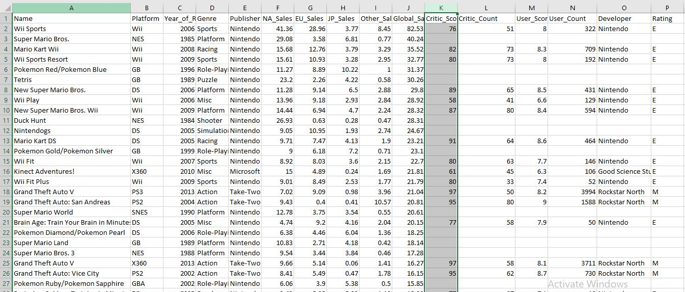
Data Understanding

Slide 7
Data Preparation
One Hot Encoding for columns ‘Genre’ and ‘Platform’ could have been done, but there is no positive effect on the analysis by doing so.
Outliers present in the Year column are fixed manually in the excel file itself.

Slide 8
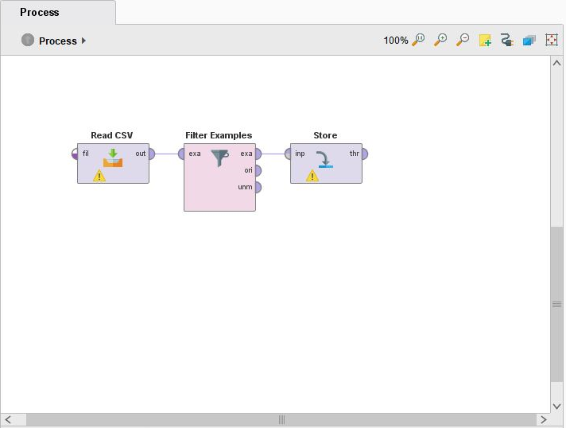
Data Preparation
Filtering NA values

Slide 9
Modeling
Auto model shows that the model with the least standard deviation and RMSE is ‘Gradient Boosted Trees’

Slide 10
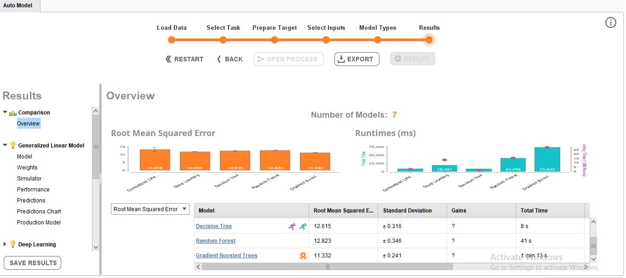
Modeling

Slide 11
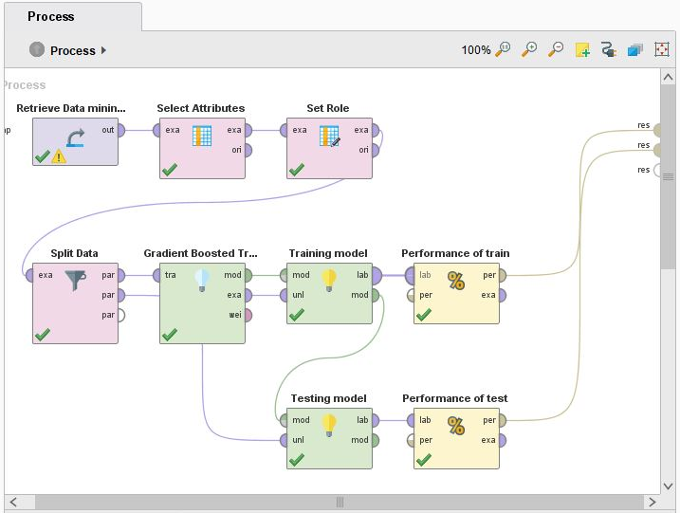
Modeling

Slide 12
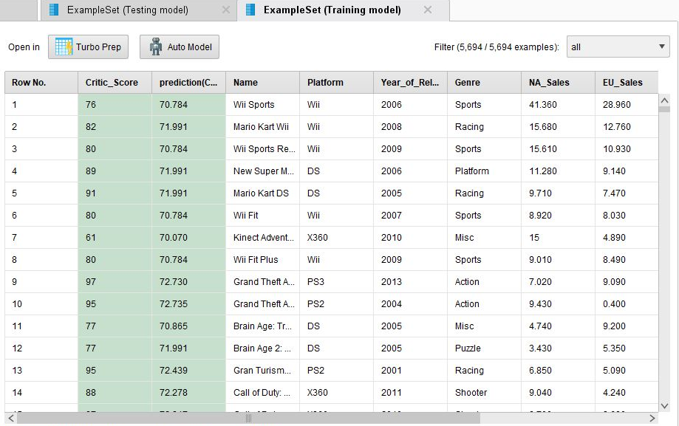
Evaluation

Slide 13
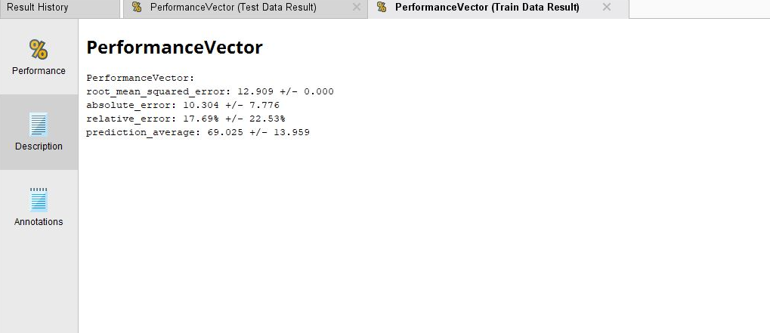
Evaluation

Slide 14
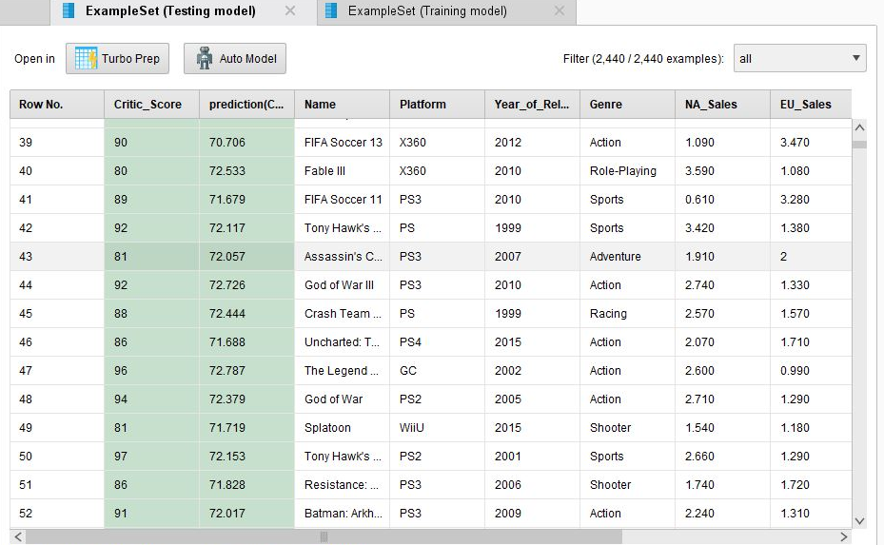
Evaluation

Slide 15
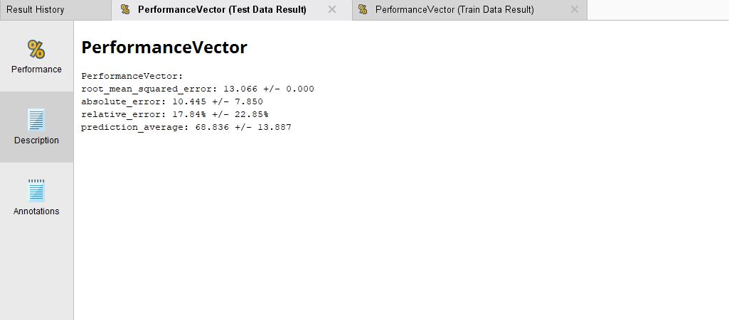
Evaluation

Slide 16
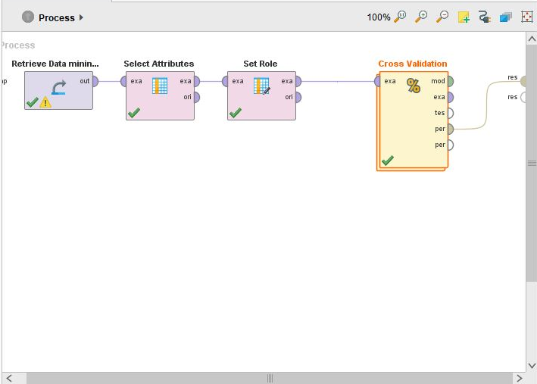
Evaluation

Slide 17
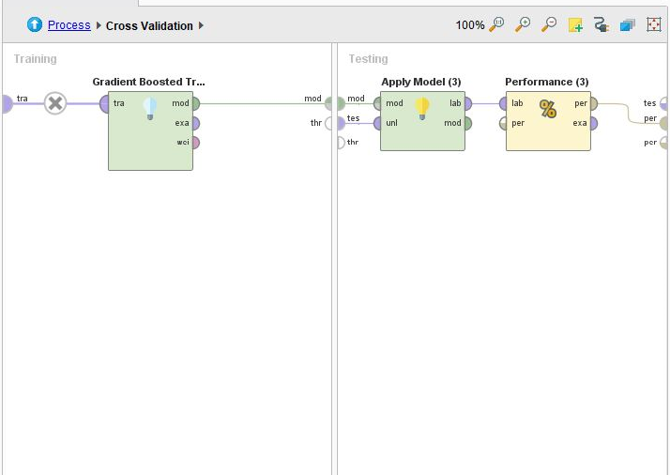
Evaluation

Slide 18
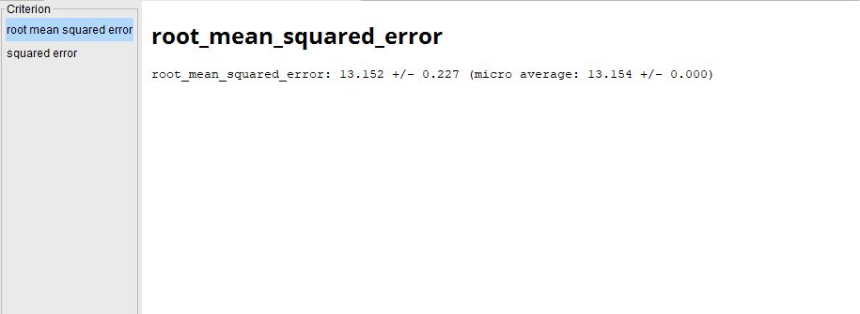
Evaluation

Slide 19
Conclusion
Thus we have created a model using the Gradient Boosted Trees algorithm to predict the Critic scores using RapidMiner.

Slide 20
Thank you !!

